Slide 1
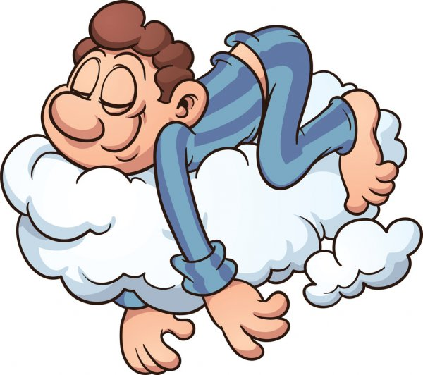
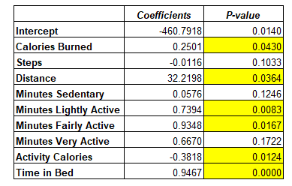
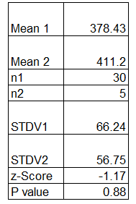
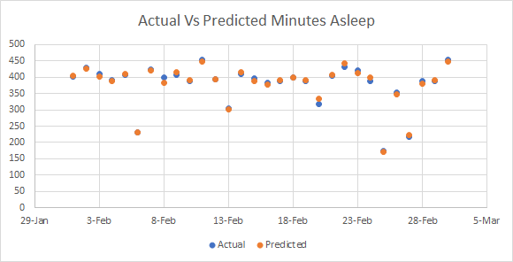
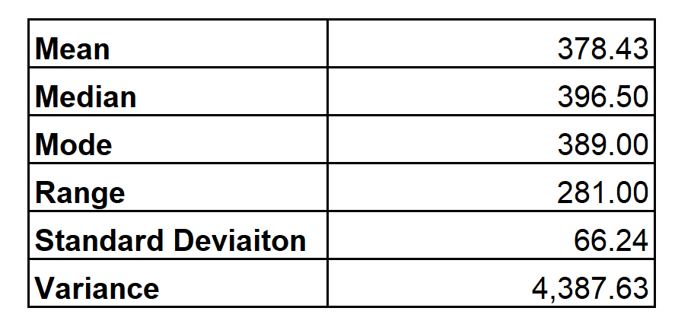
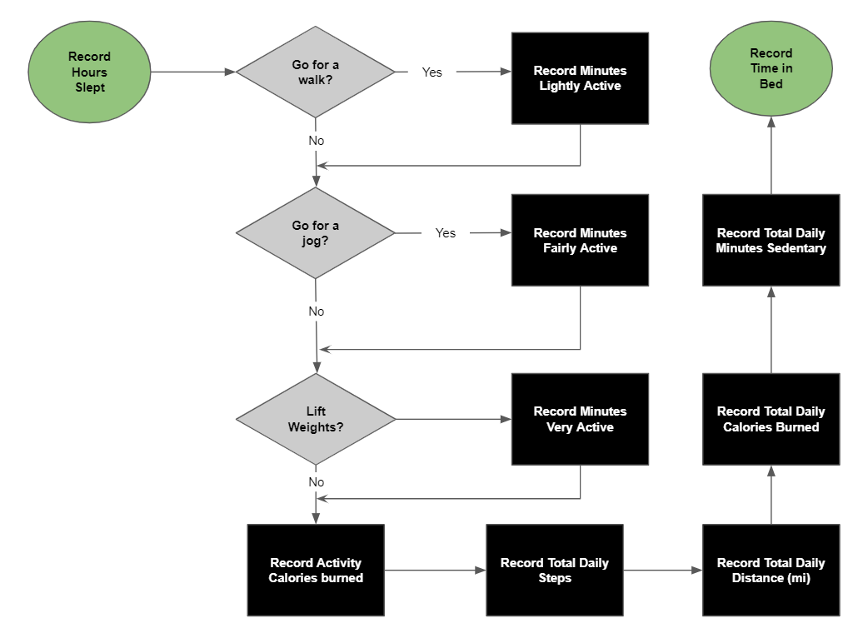
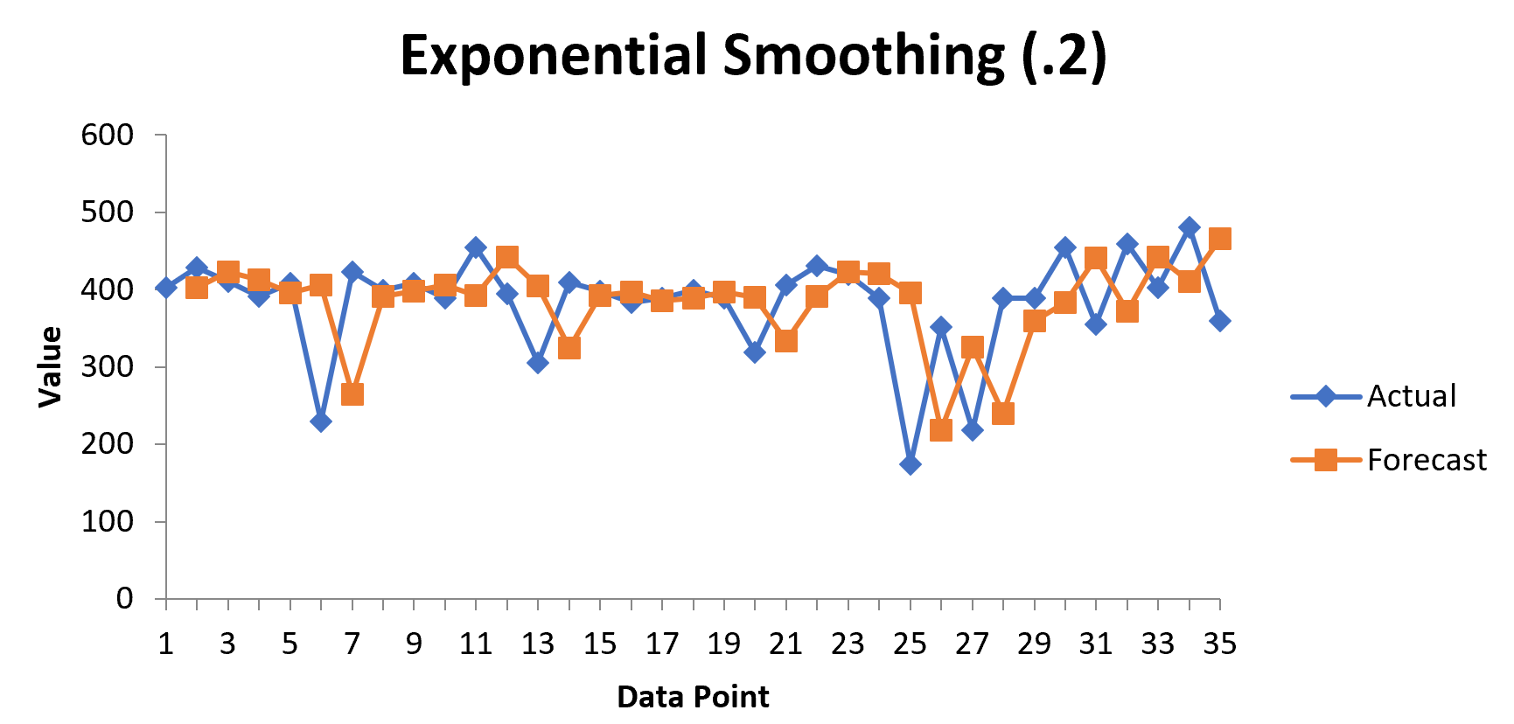
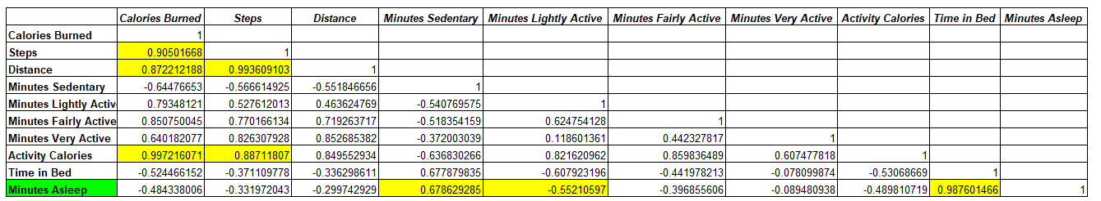
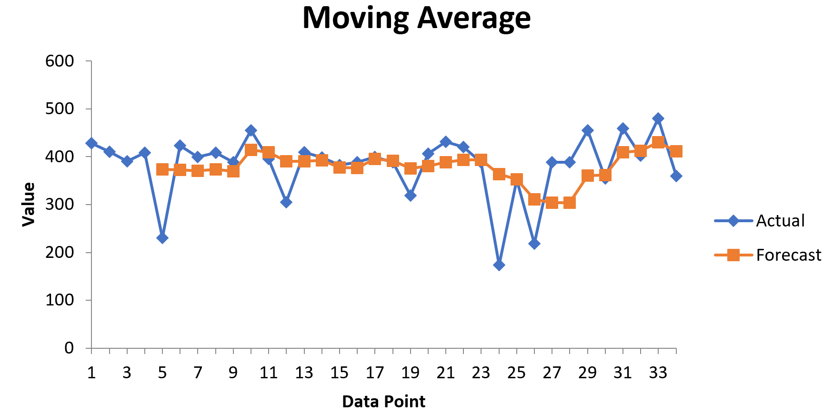
Project - Increasing Time Asleep
Process Owner: George Smith
Key Dates --->
Define
Measure
Analyze
Improve
Control
Week 1
Week 2
Week 3-7
Week 8-9
Week 9
DEFINE
MEASURE
ANALYZE
Regression analysis gone wrong
IMPROVE
Purpose: Sleep deprivation has been proven to have longtime adverse effects on memory, mood, immune system, blood pressure, weight, and heart disease.
Type of Data: Time, Continuous
Defect Opportunity Per Measurement | D | 5
Measurements | U | 4
Total Possible Defects | D x U | 20
Total Actual Defects | A | 0
Defect Per Opportunity Rate | A/DU = DPO | 0%
Defects Per Million | DPMO | 0
Sigma Quality Level | SQL | 6.0
Inputs(x) : Calories Burned, Steps, Distance, Minutes Sedentary, Minutes Lightly Active, Minutes Fairly Active, Minutes Very Active, Activity Calories, Time in Bed
Impact: Increased time slept per night has been proven to have positive effects on cognitive function, mood, health, and physical prowess.
Output (y) : Minutes slept per night
Baseline
Two tailed hypothesis test
CONTROL
New SQL
Defect opportunity per Measurement | D | 30
Measurements | U | 4
Total Possible Defects | D x U | 120
Total Actual Defects | A | 9
Defect Per Opportunity Rate | A/DU = DPO | 7.5%
Defects Per Million | DPMO | 75,000
Sigma Quality Level | SQL | 2.9
Scatter plot details accurate predicted output
Damping factor of .2 had better results than .8
Goal: Increase sleep by an average of 15 minutes per night
Estimated output of 360.6
Project Team: George Smith
Baseline SQL of 2.9
Correlation analysis shows minutes sedentary as what I should focus on improving
Notes:
1

Slide 2
DEFINE
Clearly identify the business problem /performance gap, customer, scope, goals and resources.
PROBLEM AND IMPACT
The Purpose of this process improvement project is to increase my time slept per night
Problem Statement:
Sleep deprivation has been proven to have longtime adverse effects on memory, mood, immune system, blood pressure, weight, and heart disease.
Impact:
Why should I fix this problem? I have found myself too tired to adequately juggle work, school, gym, and family responsibilities. Increased sleep time has been proven to have positive effects on cognitive function, mood, health, and physical prowess.
Estimated Benefit for fixing this problem: Increased sleep time will leave me with more energy to focus on my physical health and have benefits to my mental wellbeing.
What is the problem worth in dollars? Positive effects on cognitive function and physical prowess can lead to increased bonus from my job, and better utilization of my $120 a month gym membership.
How Will I Measure Success? Increased time slept
Main Output? Minutes slept per night
Goal: Increase time spent asleep by 15 min per night

Slide 3
DEFINE
Process Map
Record Sleep Time
Go for a walk?
Record Minutes Lightly Active
Record Time in Bed
Yes
No
Go for a jog?
Record Minutes Fairly Active
Record Total Daily Minutes Sedentary
Yes
No
Lift Weights?
Record Minutes Very Active
Record Total Daily Calories Burned
Yes
No
Record Activity Calories burned
Record Total Daily Steps
Record Total Daily Distance traveled (mi)

Slide 4
MEASURE
Validate your measurement system and collect baseline data
IDENTIFYING THE DATA
OPERATIONAL DEFINITIONS
Type of Data: All data in this project is categorized as continuous data, consisting of:
Calories Burned
Steps
Distance Traveled (mi)
Various Activity Times
Data Collection: All data was collected using a Fitbit tracker
Output (y): Minutes slept per night
Lightly Active - The act of going for a walk
Fairly Active - The act of going for a jog
Very Active - The act of weight lifting
Activity Calories - Calories burned during periods of being lightly active, fairly active, and very active
Daily Steps - Steps per day
Daily Distance Traveled - Miles traveled per day
Daily Calories Burned - Calories burned per day
Sedentary - Time spent inactive

Slide 5
MEASURE
Data Collection Plan
Performance Measure | Data Source Location | How will Data be Collected | Who Will Collect Data | When Will data be collected | Target Data Size
Calories Burned | Tracked using Technology and Manually Recorded | Fitbit Tracking Functionality | George Smith | Feb 1st - Match 2nd | 30 Samples
Steps | Tracked using Technology and Manually Recorded | Fitbit Tracking Functionality | George Smith | Feb 1st - Match 2nd | 30 Samples
Distance | Tracked using Technology and Manually Recorded | Fitbit Tracking Functionality | George Smith | Feb 1st - Match 2nd | 30 Samples
Minutes Sedentary | Tracked using Technology and Manually Recorded | Fitbit Tracking Functionality | George Smith | Feb 1st - Match 2nd | 30 Samples
Minutes Lightly Active | Tracked using Technology and Manually Recorded | Fitbit Tracking Functionality | George Smith | Feb 1st - Match 2nd | 30 Samples
Minutes Fairly Active | Tracked using Technology and Manually Recorded | Fitbit Tracking Functionality | George Smith | Feb 1st - Match 2nd | 30 Samples
Minutes Very Active | Tracked using Technology and Manually Recorded | Fitbit Tracking Functionality | George Smith | Feb 1st - Match 2nd | 30 Samples
Activity Calories | Tracked using Technology and Manually Recorded | Fitbit Tracking Functionality | George Smith | Feb 1st - Match 2nd | 30 Samples
Time in Bed | Tracked using Technology and Manually Recorded | Fitbit Tracking Functionality | George Smith | Feb 1st - Match 2nd | 30 Samples
Minutes Asleep | Tracked using Technology and Manually Recorded | Fitbit Tracking Functionality | George Smith | Feb 1st - Match 2nd | 30 Samples

Slide 6
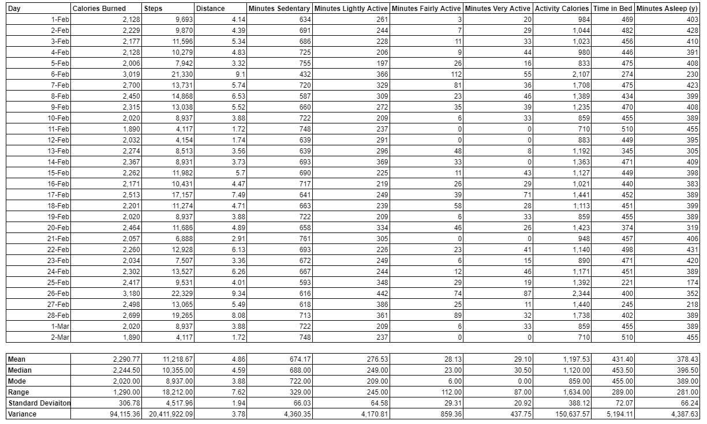
MEASURE
Input Variables
Output Variable
Descriptive Statistics
30 Days of Data
Measurement Error:
My biggest source of measurement error includes times were I engaged in activity and was not wearing my tracking device
Descriptive Statistics

Slide 7
MEASURE
Sigma Quality Level (SQL)
DEFECT
SQL CALCULATED
Defect: Underperforming the recommended daily average calories burned, steps taken, distance traveled, and minutes sedentary for a male 25 - 30 years of age, 170 - 200 pounds, and 5.7 to 6.0 ft tall.
Calories Burned: Less than 2,000 calories burned
Steps Taken: Less than 4,000 steps taken
Distance Traveled: Less than 3 miles
Minutes Sedentary: Less than 600 minutes rested
Defect opportunity per Measurement | D | 30
Measurements | U | 4
Total Possible Defects | D x U | 120
Total Actual Defects | A | 9
Defect Per Opportunity Rate | A/DU = DPO | 7.5%
Defects Per Million | DPMO | 75,000
Sigma Quality Level | SQL | 2.9
BASELINE SQL
The baseline SQL for my process was 2.9. This is considered low, as an excellent SQL would be a 6.0. The only measurement I did not experience any defects in was steps taken, as I exceeded 4,000 steps everyday during my measurement period. Ironically, I experience the most defects in my distance traveled measurement. This leads me to believe that the research I did when developing my defects may have been misguided, or I potentially take very small steps.
Note: Minutes Lightly Active, Minutes Fairly Active, Minutes Very Active, Activity Calories, Time in Bed were not considered for SQL as it was not possible to create accurate defects for the categories

Slide 8
MEASURE
Margin of Error; Sample Size
MARGIN OF ERROR
SAMPLE SIZE
I calculated my margin of error for each measurement at both the 90% confidence and 95% confidence intervals. Although my measurement process was very simple, measurement error may have occurred by forgetting to wear my tracking device. It is also important to consider that all tracking devices do not gather perfect data and there is error associated with even the most sophisticated devices.
Using my margin of error calculations, I was able to calculate the ideal sample size for each of my measurements needed at the 90% confidence interval and 95% confidence interval. I found a sample size of 30 was needed at the 90% confidence interval for all measurements, while a sample size of 21 was needed at the 95% confidence interval for all measurements.
Measurement | Margin of Error ( 90% Confidence ) | Sample Size Needed at 90% Confidence | Margin of Error (95% Confidence ) | Sample Size Needed at 95% Confidence
Calories Burned | 91.86 | 30.00 | 109.78 | 21.00
Steps | 1352.77 | 30.00 | 1616.73 | 21.00
Distance | 0.58 | 30.00 | 0.70 | 21.00
Minutes Sedentary | 19.77 | 30.00 | 23.63 | 21.00
Minutes Lightly Active | 19.34 | 30.00 | 23.11 | 21.00
Minutes Fairly Active | 8.78 | 30.00 | 10.49 | 21.00
Minutes Very Active | 6.26 | 30.00 | 7.49 | 21.00
Activity Calories | 116.21 | 30.00 | 138.89 | 21.00
Time in Bed | 21.58 | 30.00 | 25.79 | 21.00
Minutes Asleep | 19.83 | 30.00 | 23.70 | 21.00

Slide 9
ANALYZE
Correlation Analysis
INPUT VARIABLE CORRELATIONS
I conducted a correlation analysis between all my measurements to see their relationship to each other as well as my output variable (Minutes Asleep). Some logical correlations that are present included the relationship between steps and calories burned (.90), as well as the relationship between steps and distance traveled (.99). It is not surprising that as I took more steps I traveled farther and burned more calories. Additionally, there is a strong positive relationship between activity calories, calories burned (.99), and steps taken (.88). It seems reasonable that my calories burned during exercise account for most of my calories burned per day, and that steps taken is directly related to my daily activity calories.
OUTPUT VARIABLE CORRELATIONS
I was very surprised to see some of the correlations between my inputs and output variable (Minutes Asleep). My strongest positive correlation included the relationship between time in bed and minutes asleep (.98). This is an expected correlation as time in bed includes minutes asleep. I was surprised to see that my next highest positive correlation was between minutes sedentary and minutes asleep (.68). I expected that the more active I was the better I would sleep, but this relationship shows the opposite. I also found a negative correlation between minutes of light activity and minutes spent asleep (-.55).

Slide 10
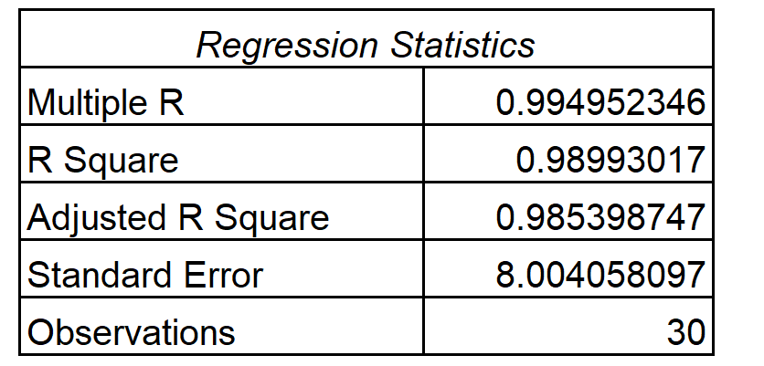
ANALYZE
Discussed in my what I did wrong section on the next slide
Regression Analysis
SLEEP TIME PREDICTED
6 variables have a p-value less than .05. These are the variables I should focus on improving
I conducted a Regression analysis to see which of my input variables I should work on improving. I included all of my input variables in my regression analysis, as a result it is important to look at the R squared value for the relationship between my input variables to my output variable minutes asleep. A .98 R squared value represents a strong relationship between my input and output variables. The reason I was able to get such a high r squared is most likely a result of time in bed being directly related to my minutes slept per night. Because of this strong relationship I was able to accurately predict my minutes spent asleep per night. This can be seen in the Actual Vs Predicted Minutes asleep graph.
Scatter Plot

Slide 11
IMPROVE
Implement a Solution
MY SOLUTION
WHAT I DID WRONG
In order to reach my goal of increasing my hours spent asleep per night. I decided to focus on increasing my time sedentary per day, and replacing my light exercise activity with heavy exercise activity. I came to this decision by analyzing my correlation analysis. There was a positive correlation between minutes sedentary and my minutes slept per night. My minutes lightly active had a negative correlation with my minutes spent asleep per night. By replacing light activity with heavy activity, I hope to be able to reach my exercise goals, while leaving more time for me to relax later in the day. My mean minutes sedentary was 674, I used this to develop my baseline of 690 for the minimum amount of time I should spend sedentary per day.
When identifying my solution you may notice I did not reference my regression analysis at all. In fact, my regression analysis and correlation analysis appear to contradict each other. When conducting my regression analysis I forgot the fundamental rule, are these relationships graphical? I assumed that all of my inputs would be linked to my output and because of this I incorrectly conducted a regression analysis on all variables.

Slide 12
IMPROVE
New SQL and Hypothesis Test
NEW SQL
NEW SQL CALCULATION
After implementing my potential solution I received a new SQL of 6.0. I believe this is somewhat misleading as my sample size was very small compared to my initial measurements, which lead to a much smaller chance of receiving defects.
Defect Opportunity Per Measurement | D | 5
Measurements | U | 4
Total Possible Defects | D x U | 20
Total Actual Defects | A | 0
Defect Per Opportunity Rate | A/DU = DPO | 0%
Defects Per Million | DPMO | 0
HYPOTHESIS TEST
I conducted a two-sample, continuous, right-tailed hypothesis test with an alpha value of .05 to see if my new mean value was meaningfully different from my original mean. I got a P-value of .88 which was not less than alpha. Because of this I cannot reject the null hypothesis and concluded the new mean is not meaningfully different from my previous mean. I believe my small sample size had an effect on my P-value and if I had gathered more data I expect to receive a much lower P-value.

Slide 13
CONTROL
Exponential Smoothing
DAMPING FACTOR SELECTION
The exponential smoothing model uses all available data to forecast a future output value. A damping factor is used to weight the data. A factor closer to 0 applies more weight to the most recent data (.2). A factor closer to 1 provides a smoother forecast (.8). I predicted a future output value of 369.33 using the damping factor of .8 and a value of 440.6 using a damping value of .2. Based on the graphical data I would be more likely to use the predicted value of 440.6 because the graph with damping value of .2 appears to more accurately forecast my actual output values. My mean hours slept was originally 378, if we use the predicted value from the exponential smoothing model (.2) I would have reached my goal of having an extra 15 minutes per night slept.

Slide 14
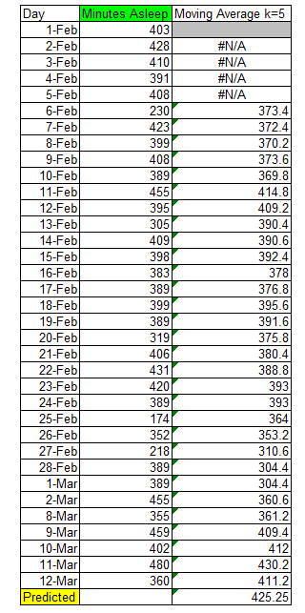
CONTROL
Moving Average Model
SLEEP TIME PREDICTED
The Moving Average model is used forecast an estimated output by averaging previous output values. I Used an interval value of 5 in my model, which takes the average of 5 days and uses these values to forecast the 6th day. My estimated output was 360.6, unfortunately this value is lower than my baseline mean hours slept (378) so this does not predict a positive improvement on my process.

